Slide 1

Methods in Thread
BCSC1002 Object Oriented Programming

Slide 2
Methods in Thread
public void run(): is used to perform action for a thread.
public void start(): starts the execution of the thread. JVM calls the run() method on the thread.
public void sleep(long miliseconds): Causes the currently executing thread to sleep (temporarily cease execution) for the specified number of milliseconds.
public int getPriority(): returns the priority of the thread.
BCSC1002 Object Oriented Programming

Slide 3
Methods in Thread
public int setPriority(int priority): changes the priority of the thread.
public String getName(): returns the name of the thread.
public void setName(String name): changes the name of the thread.
public Thread currentThread(): returns the reference of currently executing thread.
public int getId(): returns the id of the thread.
BCSC1002 Object Oriented Programming

Slide 4
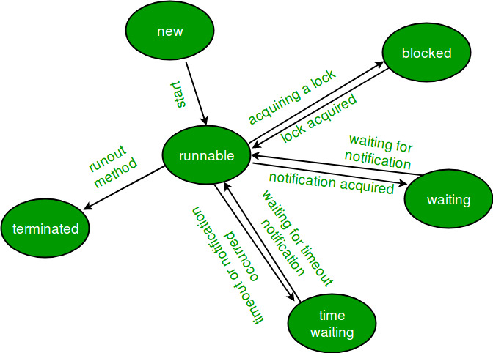
Methods in Thread
public Thread.State getState(): returns the state of the thread.
BCSC1002 Object Oriented Programming

Slide 5
Methods in Thread
public boolean isAlive(): tests if the thread is alive.
public void yield(): causes the currently executing thread object to temporarily pause and allow other threads to execute.
public void suspend(): is used to suspend the thread(depricated).
public void resume(): is used to resume the suspended thread(depricated).
BCSC1002 Object Oriented Programming

Slide 6
yield method
yield(): Suppose there are three threads t1, t2, and t3. Thread t1 gets the processor and starts its execution and thread t2 and t3 are in Ready/Runnable state. Completion time for thread t1 is 5 hour and completion time for t2 is 5 minutes. Since t1 will complete its execution after 5 hours, t2 has to wait for 5 hours to just finish 5 minutes job. In such scenarios where one thread is taking too much time to complete its execution, we need a way to prevent execution of a thread in between if something important is pending. yield() helps us in doing so. yield() basically means that the thread is not doing anything particularly important and if any other threads or processes need to be run, they should run. Otherwise, the current thread will continue to run.
BCSC1002 Object Oriented Programming

Slide 7
Use of yield method
Whenever a thread calls java.lang.Thread.yield method, it gives hint to the thread scheduler that it is ready to pause its execution. Thread scheduler is free to ignore this hint.
If any thread executes yield method, thread scheduler checks if there is any thread with same or high priority than this thread. If processor finds any thread with higher or same priority then it will move the current thread to Ready/Runnable state and give processor to other thread and if not – current thread will keep executing.
BCSC1002 Object Oriented Programming

Slide 8
Use of yield method
Once a thread has executed yield method and there are many threads with same priority is waiting for processor, then we can’t specify which thread will get execution chance first.
The thread which executes the yield method will enter in the Runnable state from Running state.
Once a thread pauses its execution, we can’t specify when it will get chance again it depends on thread scheduler.
BCSC1002 Object Oriented Programming

Slide 9
Use of sleep method
sleep(): This method causes the currently executing thread to sleep for the specified number of milliseconds, subject to the precision and accuracy of system timers and schedulers.
Note:
Based on the requirement we can make a thread to be in sleeping state for a specified period of time
Sleep() causes the thread to definitely stop executing for a given amount of time; if no other thread or process needs to be run, the CPU will be idle (and probably enter a power saving mode).
BCSC1002 Object Oriented Programming

Slide 10
Use of join method
join(): The join() method of a Thread instance is used to join the start of a thread’s execution to end of other thread’s execution such that a thread does not start running until another thread ends. If join() is called on a Thread instance, the currently running thread will block until the Thread instance has finished executing.
The join() method waits at most this much milliseconds for this thread to die. A timeout of 0 means to wait forever
BCSC1002 Object Oriented Programming

Slide 11
Use of join method
Note:
If any executing thread t1 calls join() on t2 i.e; t2.join() immediately t1 will enter into waiting state until t2 completes its execution.
Giving a timeout within join(), will make the join() effect to be nullified after the specific timeout.
BCSC1002 Object Oriented Programming

Slide 12
Methods in Thread
public void stop(): is used to stop the thread(depricated).
public void interrupt(): interrupts the thread.
public boolean isInterrupted(): tests if the thread has been interrupted.
public static boolean interrupted(): tests if the current thread has been interrupted.
BCSC1002 Object Oriented Programming

Slide 13
interrupt()
Invoking interrupt() method just gives a hint to JVM to interrupt but it is not mandatory. Actually, interrupt() is applied on the thread if and if only a thread is blocked by one of these methods such as wait(), join() and sleep() methods. If a thread is not having these methods then the thread will not be interrupted in middle. That means Thread will do its job till the end.
BCSC1002 Object Oriented Programming

Slide 14
Deadlock
In a multiprogramming environment, several processes may compete for a finite number of resources. A process requests resources; if the resources are not available at that time, the process enters a waiting state. Sometimes, a waiting process is never again able to change state, because the resources it has requested are held by other waiting processes. This situation is called a deadlock.
BCSC1002 Object Oriented Programming

Slide 15
Deadlock
A process must request a resource before using it and must release the resource after using it. A process may request as many resources as it requires to carry out its designated task. Obviously, the number of resources requested may not exceed the total number of resources available in the system. In other words, a process cannot request three printers if the system has only two.
Under the normal mode of operation, a process may utilize a resource in only the following sequence:
Request. The process requests the resource. If the request cannot be granted immediately (for example, if the resource is being used by another process), then the requesting process must wait until it can acquire the resource.
Use. The process can operate on the resource (for example, if the resource is a printer, the process can print on the printer).
Release. The process releases the resource.
BCSC1002 Object Oriented Programming

Slide 16
Synchronization
Synchronization in Java:
Synchronization in Java is the capability to control the access of multiple threads to any shared resource.
Java Synchronization is better option where we want to allow only one thread to access the shared resource.
Why use Synchronization?
The synchronization is mainly used to:
To prevent thread interference.
To prevent consistency problem.
Types of Synchronization:
There are two types of synchronization:
Process Synchronization
Thread Synchronization
BCSC1002 Object Oriented Programming

Slide 17
Synchronization
Thread Synchronization:
There are two types of thread synchronization mutual exclusive and inter-thread communication.
Mutual Exclusive
Synchronized method.
Synchronized block.
Static synchronization.
Cooperation (Inter-thread communication in java)
Mutual Exclusive:
Mutual Exclusive helps keep threads from interfering with one another while sharing data. It can be achieved by using the following three ways:
By Using Synchronized Method
By Using Synchronized Block
By Using Static Synchronization
BCSC1002 Object Oriented Programming

Slide 18
Synchronization
Concept of Lock in Java:
Synchronization is built around an internal entity known as the lock or monitor. Every object has a lock associated with it. By convention, a thread that needs consistent access to an object's fields has to acquire the object's lock before accessing them, and then release the lock when it's done with them.
From Java 5 the package java.util.concurrent.locks contains several lock implementations.
BCSC1002 Object Oriented Programming

Slide 19
Locks
Locks are one synchronization technique. A lock is an abstraction that allows at most one thread to own it at a time. Holding a lock is how one thread tells other threads: “I’m changing this thing, don’t touch it right now.”
Locks have two operations:
Acquire: allows a thread to take ownership of a lock. If a thread tries to acquire a lock currently owned by another thread, it blocks until the other thread releases the lock. At that point, it will contend with any other threads that are trying to acquire the lock. At most one thread can own the lock at a time.
Release: relinquishes ownership of the lock, allowing another thread to take ownership of it.
BCSC1002 Object Oriented Programming

Slide 20
Thank You
BCSC1002 Object Oriented Programming

